Slide 1



PhD Progress Meeting 2013
Development of Multimodal Quantitative MRI Techniques to Assess Brain Tissue Microstructure in Multiple Sclerosis
Mathieu Boudreau
November 25th 2013
Biomedical Engineering Dept.
McGill University
Committee:
Prof. Bruce Pike – Supervisor
Dr. Douglas Arnold - External member
Prof. Robert Funnell - Chair’s representative

Slide 2
Overview
Introduction
Reminder of Hypotheses
Progress
Publications/Abstracts
Work on Aim 1
Upcoming Research Plan/ Timeline
Aim 1: qMT compressed sensing
Aim 1: Completion of ISMRM work
Aim 2: Post-mortem MS qMT
Aim 3: MS Patient whole-brain qMT
Notes:
BRIEF OVERVIEW OF Report

Slide 3
Introduction
Multiple Sclerosis: disabling neurological disease affecting 55,000-75,000 Canadians.
MRI: imaging modality uniquely sensitive to many aspects of MS pathology.
Quantitative Magnetization Transfer: MRI technique capable of quantifying changes in myelin density.
Most qMT research of MS concentrate on white matter pathology, partly due to time and resolution limitations.
We aim to develop a fast high-resolution qMT method for white and gray matter MS pathology in the whole-brain to investigate the spatial relationship between pathology in both tissues.
3
Notes:
TRIGGER of MS is unknown
there is currently NO CURE

Slide 4
Introduction
Multiple Sclerosis: disabling neurological disease affecting 55,000-75,000 Canadians.
MRI: imaging modality uniquely sensitive to many aspects of MS pathology.
Quantitative Magnetization Transfer: MRI technique capable of quantifying changes in myelin density.
Most qMT research of MS concentrate on white matter pathology, partly due to time and resolution limitations.
We aim to develop a fast high-resolution qMT method for white and gray matter MS pathology in the whole-brain to investigate the spatial relationship between pathology in both tissues.
3
Notes:
CONVENTIONAL MRI – CLINICAL DIAGNOSIS

Slide 5
Introduction
Multiple Sclerosis: disabling neurological disease affecting 55,000-75,000 Canadians.
MRI: imaging modality uniquely sensitive to many aspects of MS pathology.
Quantitative Magnetization Transfer: MRI technique capable of quantifying changes in myelin density.
Most qMT research of MS concentrate on white matter pathology, partly due to time and resolution limitations.
We aim to develop a fast high-resolution qMT method for white and gray matter MS pathology in the whole-brain to investigate the spatial relationship between pathology in both tissues.
3
Notes:
SOME MT MEASURES CORRELATE WITH MYELIN DENSITY

Slide 6
Introduction
Multiple Sclerosis: disabling neurological disease affecting 55,000-75,000 Canadians.
MRI: imaging modality uniquely sensitive to many aspects of MS pathology.
Quantitative Magnetization Transfer: MRI technique capable of quantifying changes in myelin density.
Most qMT research of MS concentrate on white matter pathology, partly due to time and resolution limitations.
We aim to develop a fast high-resolution qMT method for white and gray matter MS pathology in the whole-brain to investigate the spatial relationship between pathology in both tissues.
3
Notes:
qMT FOCUS WM LESIONS. RES LIMIT
+ MS CONSIDERED A WM DISEASE

Slide 7
Introduction
Multiple Sclerosis: disabling neurological disease affecting 55,000-75,000 Canadians.
MRI: imaging modality uniquely sensitive to many aspects of MS pathology.
Quantitative Magnetization Transfer: MRI technique capable of quantifying changes in myelin density.
Most qMT research of MS concentrate on white matter pathology, partly due to time and resolution limitations.
We aim to develop a fast high-resolution qMT method for white and gray matter MS pathology in the whole-brain to investigate the spatial relationship between pathology in both tissues.
3

Slide 8
Hypotheses
Whole-brain qMT maps can be acquired with a resolution of 1 mm³ in a clinically acceptable time of < 30 minutes.
High-resolution qMT WM/GM focal and diffuse pathology in post-mortem healthy and MS brains will correlate with immunohistochemistry measurements of pathology.
Is cortical GM MS pathology spatially independent of connectivity with WM lesions?
4
Notes:
3 HYPOTHESES FOR THIS PROECT ARE THE FOLLOWING

Slide 9
Hypotheses
Whole-brain qMT maps can be acquired with a resolution of 1 mm³ in a clinically acceptable time of < 30 minutes.
High-resolution qMT WM/GM focal and diffuse pathology in post-mortem healthy and MS brains will correlate with immunohistochemistry measurements of pathology.
Is cortical GM MS pathology spatially independent of connectivity with WM lesions?
4

Slide 10
Hypotheses
Whole-brain qMT maps can be acquired with a resolution of 1 mm³ in a clinically acceptable time of < 30 minutes.
High-resolution qMT WM/GM focal and diffuse pathology in post-mortem healthy and MS brains will correlate with immunohistochemistry measurements of pathology.
Is cortical GM MS pathology spatially independent of connectivity with WM lesions?
4

Slide 11
List of Publications/Abstracts
Submitted Manuscripts
Nikola Stikov, Mathieu Boudreau, Ives Levesque, Christine Tardif, Joëlle Barral, G. Bruce Pike, “On the Accuracy of T₁ Mapping: Searching for Common Ground”, Submitted to: Magnetic Resonance in Medicine
Accepted Conference Abstracts
Mathieu Boudreau, Nikola Stikov, G. Bruce Pike, “T₁ Mapping: Should We Agree To Disagree?”, Poster, International Society for Magnetic Resonance in Medicine Meeting 2013
Mathieu Boudreau, Nikola Stikov, G. Bruce Pike, “Effect of Different T₁ Mapping Techniques on a Quantitative Magnetization Transfer MRI Biomarker for Myelin Density”, Poster, endMS Conference 2013
Submitted Conference Abstracts
Mathieu Boudreau, Christine Tardif, Nikola Stikov, G. Bruce Pike, “A Comparison of B₁ Mapping Methods for T₁ Mapping at 3T”, Submitted to: International Society for Magnetic Resonance in Medicine Meeting 2014
Mathieu Boudreau, Nikola Stikov, G. Bruce Pike, “A B₁ Insensitive qMT Protocol”, Submitted to: International Society for Magnetic Resonance in Medicine Meeting 2014
Ye Gu, Nikola Stikov, Mathieu Boudreau, Yaaseen Atchia, Ives Levesque, John Sled, G. Bruce Pike, “qMTLab: An Open Source Software Package for Quantitative Analysis of Magnetization Transfer”, Submitted to: International Society for Magnetic Resonance in Medicine Meeting 2014
5

Slide 12
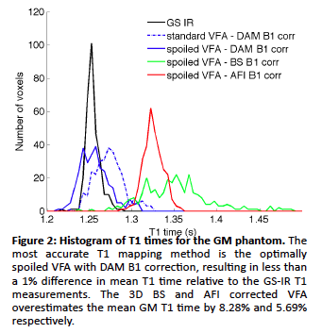
Progress – Aim 1 Section 4.1: Quantitative Comparison of B₁ Mapping Methods for White Matter T₁ Mapping at 3T
Continuation of Dr. Tardifs 2011 ISMRM work – a comparison B₁ methods on VFA T₁ values, in phantoms.
Fits in Aim 1, whole brain qMT protocols will require rapid B₁ mapping techniques such as Actual-Flip-Angle Imaging (AFI)
This work compared VFA T₁ maps in healthy WM using 4 B₁ methods: Reference DA, BS, AFI, and EPI-DA.
Tardif et al, ISMRM 2011
6

Slide 13
Progress – Aim 1 Section 4.1: Quantitative Comparison of B₁ Mapping Methods for White Matter T₁ Mapping at 3T
Continuation of Dr. Tardifs 2011 ISMRM work – a comparison B₁ methods on VFA T₁ values, in phantoms.
Fits in Aim 1, whole brain qMT protocols will require rapid B₁ mapping techniques such as Actual-Flip-Angle Imaging (AFI)
This work compared VFA T₁ maps in healthy WM using 4 B₁ methods: Reference DA, BS, AFI, and EPI-DA.
Tardif et al, ISMRM 2011
6

Slide 14
Progress – Aim 1 Section 4.1: Quantitative Comparison of B₁ Mapping Methods for White Matter T₁ Mapping at 3T
Continuation of Dr. Tardifs 2011 ISMRM work – a comparison B₁ methods on VFA T₁ values, in phantoms.
Fits in Aim 1, whole brain qMT protocols will require rapid B₁ mapping techniques such as Actual-Flip-Angle Imaging (AFI)
This work compared VFA T₁ maps in healthy WM using 4 B₁ methods: Reference DA, BS, AFI, and EPI-DA.
Tardif et al, ISMRM 2011
6

Slide 15
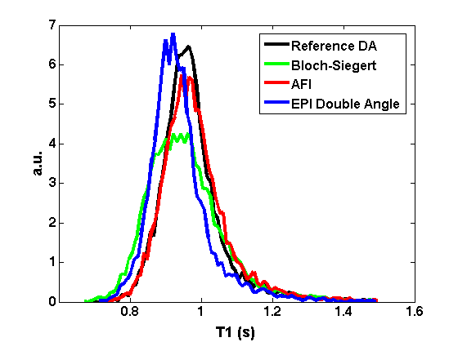
Progress – Aim 1 Section 4.1: Quantitative Comparison of B₁ Mapping Methods for White Matter T₁ Mapping at 3T
All B₁ methods provided comparable B₁ and VFA T₁ maps.
EPI-DA (5 s/slice), the fastest method, had no observable distortion.
Fig. 2 - Normalized pooled histograms of single slice WM T₁ values for 6 healthy subjects.
Figure 1 – B₁ and VFA T₁ map comparison.
7

Slide 16
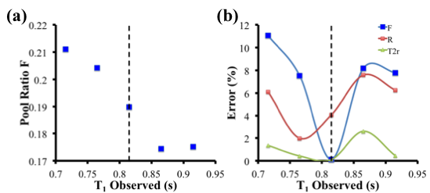
Progress – Aim 1 Section 4.2: Effect of Different T₁ Mapping Techniques on a Quantitative Magnetization Transfer MRI Biomarker for Myelin Density
Last year: Simulated the effect of erroneous T₁ measurements on qMT.
To shorten the acquisition time of whole brain qMT, the conventional LL T₁ measurements must be replaced by a rapid T₁ technique.
Three commonly used T₁ techniques (IR, LL, VFA) have been recently shown to disagree significantly in vivo.
This study investigated the effects of different T₁ techniques on qMT parameters in WM of healthy subjects.
Fig. 3 Effect on qMT fitted parameters as a result of measuring a T₁ value different from the true tissue T₁ value (dotted line).
8

Slide 17
Progress – Aim 1 Section 4.2: Effect of Different T₁ Mapping Techniques on a Quantitative Magnetization Transfer MRI Biomarker for Myelin Density
Last year: Simulated the effect of erroneous T₁ measurements on qMT.
To shorten the acquisition time of whole brain qMT, the conventional LL T₁ measurements must be replaced by a rapid T₁ technique.
Three commonly used T₁ techniques (IR, LL, VFA) have been recently shown to disagree significantly in vivo.
This study investigated the effects of different T₁ techniques on qMT parameters in WM of healthy subjects.
Fig. 3 Effect on qMT fitted parameters as a result of measuring a T₁ value different from the true tissue T₁ value (dotted line).
8

Slide 18
Progress – Aim 1 Section 4.2: Effect of Different T₁ Mapping Techniques on a Quantitative Magnetization Transfer MRI Biomarker for Myelin Density
Last year: Simulated the effect of erroneous T₁ measurements on qMT.
To shorten the acquisition time of whole brain qMT, the conventional LL T₁ measurements must be replaced by a rapid T₁ technique.
Three commonly used T₁ techniques (IR, LL, VFA) have been recently shown to disagree significantly in vivo.
This study investigated the effects of different T₁ techniques on qMT parameters in WM of healthy subjects.
Fig. 3 Effect on qMT fitted parameters as a result of measuring a T₁ value different from the true tissue T₁ value (dotted line).
8

Slide 19
Progress – Aim 1 Section 4.2: Effect of Different T₁ Mapping Techniques on a Quantitative Magnetization Transfer MRI Biomarker for Myelin Density
Last year: Simulated the effect of erroneous T₁ measurements on qMT.
To shorten the acquisition time of whole brain qMT, the conventional LL T₁ measurements must be replaced by a rapid T₁ technique.
Three commonly used T₁ techniques (IR, LL, VFA) have been recently shown to disagree significantly in vivo.
This study investigated the effects of different T₁ techniques on qMT parameters in WM of healthy subjects.
Fig. 3 Effect on qMT fitted parameters as a result of measuring a T₁ value different from the true tissue T₁ value (dotted line).
8

Slide 20
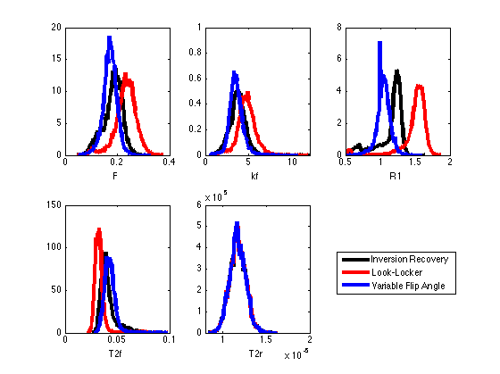
Progress – Aim 1 Section 4.2: Effect of Different T₁ Mapping Techniques on a Quantitative Magnetization Transfer MRI Biomarker for Myelin Density
Six healthy subjects were scanned as part of the protocol of our ISMRM study.
The overestimation in VFA T₁ values deviated F away from IR less than for LL.
Fig. 4 Normalized pooled histograms of single slice WM quantitative MT parameter values for 6 healthy subjects .
9

Slide 21
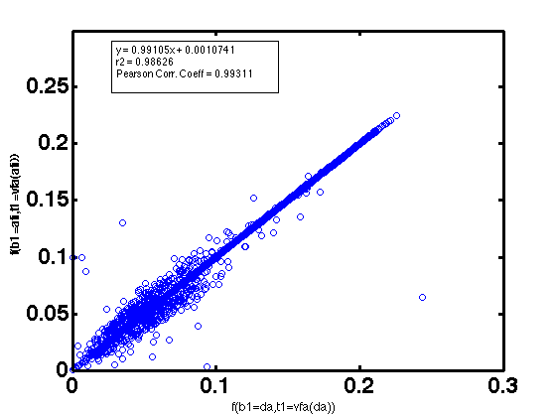
Progress – Aim 1 Section 4.3: Insensitivity of B₁ on our qMT Protocol
An unexpected result (Fig) was observed when comparing qMT maps with different B₁ maps + VFA T₁ maps.
Here, B₁ is used twice before fitting the qMT parameters: to correct the flip angles for T₁ mapping, and to scale the nominal MT saturation powers.
What is the limit of this insensitivity to B₁ maps on qMT F?
AFI
WM
DA
Fig. 6 Scatter plot of qMT F values calculating using VFA T₁, and DA B₁ maps (horizontal axis) and AFI B₁ maps (vertical).
10

Slide 22
Progress – Aim 1 Section 4.3: Insensitivity of B₁ on our qMT Protocol
An unexpected result (Fig) was observed when comparing qMT maps with different B₁ maps + VFA T₁ maps.
Here, B₁ is used twice before fitting the qMT parameters: to correct the flip angles for T₁ mapping, and to scale the nominal MT saturation powers.
What is the limit of this insensitivity to B₁ maps on qMT F?
AFI
WM
DA
Fig. 6 Scatter plot of qMT F values calculating using VFA T₁, and DA B₁ maps (horizontal axis) and AFI B₁ maps (vertical).
10

Slide 23
Progress – Aim 1 Section 4.3: Insensitivity of B₁ on our qMT Protocol
An unexpected result (Fig) was observed when comparing qMT maps with different B₁ maps + VFA T₁ maps.
Here, B₁ is used twice before fitting the qMT parameters: to correct the flip angles for T₁ mapping, and to scale the nominal MT saturation powers.
What is the limit of this insensitivity to B₁ maps on qMT F?
AFI
WM
DA
Fig. 6 Scatter plot of qMT F values calculating using VFA T₁, and DA B₁ maps (horizontal axis) and AFI B₁ maps (vertical).
10

Slide 24
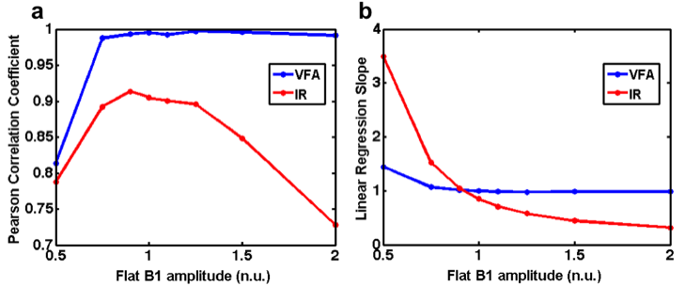
Progress – Aim 1 Section 4.3: Insensitivity of B₁ on our qMT Protocol
Comparison between DA B₁ and Flat (homogeneous ) B₁ maps
The exact origin of the erroneous B₁, and subsequently VFA T₁, nearly cancelling out in qMT F maps remains to be clarified.
Fig. 8 Pooled (all subjects) whole brain Pearson correlation coefficients (a) and linear regression slopes (b) for qMT F values between the measured DA B₁ maps and simulated flat B₁ maps.
Fig. 7 Comparison of qMT F maps fitted using DA and flat (B₁ = 1) B₁ maps and VFA T₁ maps.
11

Slide 25
Progress – Aim 1 Section 4.3: Insensitivity of B₁ on our qMT Protocol
Comparison between DA B₁ and Flat (homogeneous ) B₁ maps
The exact origin of the erroneous B₁, and subsequently VFA T₁, nearly cancelling out in qMT F maps remains to be clarified.
Fig. 8 Pooled (all subjects) whole brain Pearson correlation coefficients (a) and linear regression slopes (b) for qMT F values between the measured DA B₁ maps and simulated flat B₁ maps.
Fig. 7 Comparison of qMT F maps fitted using DA and flat (B₁ = 1) B₁ maps and VFA T₁ maps.
11

Slide 26
Progress – Aim 1 Section 4.4: qMT Compressed Sensing
Developed sparse k-space 2D GRE sequence (base sequence for our qMT sequences)
Single point qMT sequence, UI MT parameter control (MT saturation, off-resonance frequency).
Siemens raw data Matlab code
An open source 3D L₁-SPIRIT multi-channel sparse acquisition image reconstruction software package was installed and tested .
12

Slide 27
Progress – Aim 1 Section 4.4: qMT Compressed Sensing
Developed sparse k-space 2D GRE sequence (base sequence for our qMT sequences)
Single point qMT sequence, UI MT parameter control (MT saturation, off-resonance frequency).
Siemens raw data Matlab code
An open source 3D L₁-SPIRIT multi-channel sparse acquisition image reconstruction software package was installed and tested .
12

Slide 28
Progress – Aim 1 Section 4.4: qMT Compressed Sensing
Developed sparse k-space 2D GRE sequence (base sequence for our qMT sequences)
Single point qMT sequence, UI MT parameter control (MT saturation, off-resonance frequency).
Siemens raw data Matlab code
An open source 3D L₁-SPIRIT multi-channel sparse acquisition image reconstruction software package was installed and tested .
12

Slide 29
Progress – Aim 1 Section 4.4: qMT Compressed Sensing
Developed sparse k-space 2D GRE sequence (base sequence for our qMT sequences)
Single point qMT sequence, UI MT parameter control (MT saturation, off-resonance frequency).
Siemens raw data Matlab code
An open source 3D L₁-SPIRIT multi-channel sparse acquisition image reconstruction software package was installed and tested .
12

Slide 30
Upcoming Research Plan Sections 5.1 & 6.1: qMT Compressed Sensing December 2013 - May 2014
qMT point by point sensitivity to CS-reconstruction
L₁-Spirit+Wavelet reconstruction
Using single slice, 2x2x5 mm³ qMT data (5 healthy subjects)
Using whole brain, 2x2x2 mm³ qMT data (1 RRMS patient)
Evaluate feasibility of locally low rank sparsity reconstruction
Try on-hand data first
May need to acquire more data
LLR sensitive to in-scan motion
Acquire small set of whole brain hi-res qMT
Compare qMT-point optimized L₁-Spirit with LLR
13

Slide 31
Upcoming Research Plan Sections 5.1 & 6.1: qMT Compressed Sensing December 2013 - May 2014
qMT point by point sensitivity to CS-reconstruction
L₁-Spirit+Wavelet reconstruction
Using single slice, 2x2x5 mm³ qMT data (5 healthy subjects)
Using whole brain, 2x2x2 mm³ qMT data (1 RRMS patient)
Evaluate feasibility of locally low rank sparsity reconstruction
Try on-hand data first
May need to acquire more data
LLR sensitive to in-scan motion
Acquire small set of whole brain hi-res qMT
Compare qMT-point optimized L₁-Spirit with LLR
13

Slide 32
Upcoming Research Plan Sections 5.1 & 6.1: qMT Compressed Sensing December 2013 - May 2014
qMT point by point sensitivity to CS-reconstruction
L₁-Spirit+Wavelet reconstruction
Using single slice, 2x2x5 mm³ qMT data (5 healthy subjects)
Using whole brain, 2x2x2 mm³ qMT data (1 RRMS patient)
Evaluate feasibility of locally low rank sparsity reconstruction
Try on-hand data first
May need to acquire more data
LLR sensitive to in-scan motion
Acquire small set of whole brain hi-res qMT
Compare qMT-point optimized L₁-Spirit with LLR
13

Slide 33
Upcoming Research Plan Sections 5.2 & 6.1: Complete ISMRM work December 2013 - May 2014
Simulate qMT sensitivity to B₁ (for T₁ = VFA(B₁), IR)
Modify current qMT simulation code
Tissue parameters
Pure WM
Pure GM
WM/GM partial volume
GM/CSF partial volume
Compare smoothed and blurred B₁ maps for all methods
Better agreement in overall T₁ maps?
14

Slide 34
Upcoming Research Plan Sections 5.3 & 6.2: Post-mortem MS qMT June 2014 - December 2014
Optimize qMT pulse sequence for reductions in post-mortem brains T₁ values due to formaldehyde fixation.
Post-mortem brain hemispheres (1 healthy, 4 MS for different stages) to be scanned Summer/Fall 2014.
Statistical analysis of MRI scans and immunohistochemicaly stained coronal slices.
15

Slide 35
Upcoming Research Plan Sections 5.3 & 6.2: Post-mortem MS qMT June 2014 - December 2014
Optimize qMT pulse sequence for reductions in post-mortem brains T₁ values due to formaldehyde fixation.
Post-mortem brain hemispheres (1 healthy, 4 MS for different stages) to be scanned Summer/Fall 2014.
Statistical analysis of MRI scans and immunohistochemicaly stained coronal slices.
15

Slide 36
Upcoming Research Plan Sections 5.3 & 6.2: Post-mortem MS qMT June 2014 - December 2014
Optimize qMT pulse sequence for reductions in post-mortem brains T₁ values due to formaldehyde fixation.
Post-mortem brain hemispheres (1 healthy, 4 MS for different stages) to be scanned Summer/Fall 2014.
Statistical analysis of MRI scans and immunohistochemicaly stained coronal slices.
15

Slide 37
Upcoming Research Plan Sections 5.4, 6.3 & 6.4: In vivo whole-brain MS qMT January 2015 - August 2015
3D qMT protocol on secondary progressive MS patients and age/sex matched healthy volunteers.
Investigate cortical GM qMT values in healthy GM and GM lesions.
Acquire high angular resolution MRI diffusion tractography maps.
qMT parameters in cortical GM connected to WM lesions will be investigated to determine if they exhibit statistically different values compared to contra-lateral regions free of WM lesions.
16

Slide 38
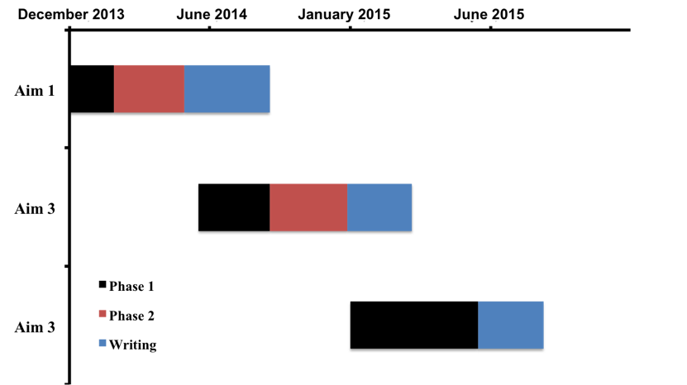
Thesis Completion Timeline
17

Slide 40
PhD Progress Meeting 2013
Development of Multimodal Quantitative MRI Techniques to Assess Brain Tissue Microstructure in Multiple Sclerosis
Mathieu Boudreau
November 25th 2013
Biomedical Engineering Dept.
McGill University
Committee:
Prof. Bruce Pike – Supervisor
Dr. Douglas Arnold - External member
Prof. Robert Funnell - Chair’s representative

